Slide 1
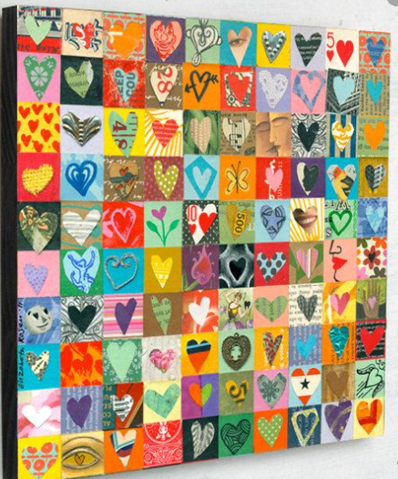
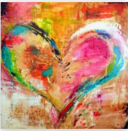
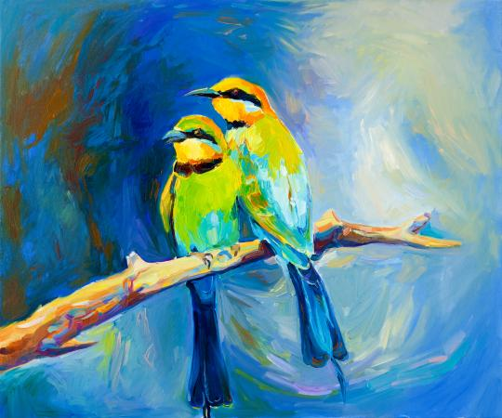
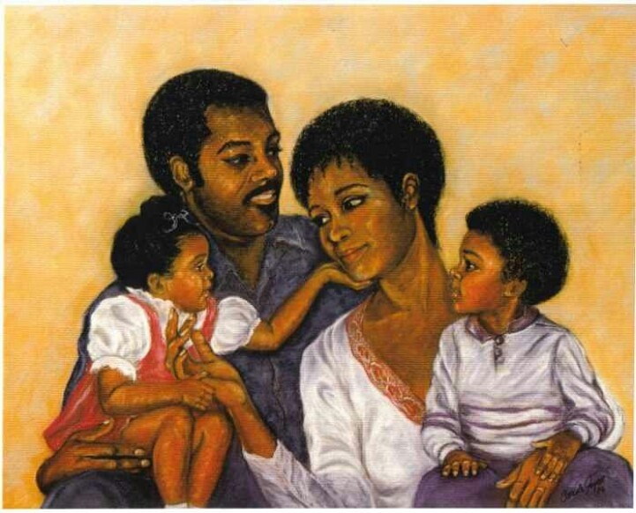
SHOW LOVE WITH ART

Slide 2
What represents love for you?
Spending time with your family?
Flowers?
Nature?
Food?
Hearts?

Slide 3
Girl with a balloon banksy UK
This has the inscription ‘There is always hope’
What do you think this artwork says about love?

Slide 4
The sweet tango of love leonid Afremov Russian–Israeli
What do you think this artwork says about love?

Slide 5
Your turn
Create a piece of art that represents love for you. Give it a title and send it to your teacher by 1st March.
You could take a photograph, do a painting, create a collage, make something 3D, create art from nature or even bake and decorate something!
How can you represent what love means to you through your art?

